Slide 1
FPGA Autonoma Processor Accelerator
12/04/23

Slide 2
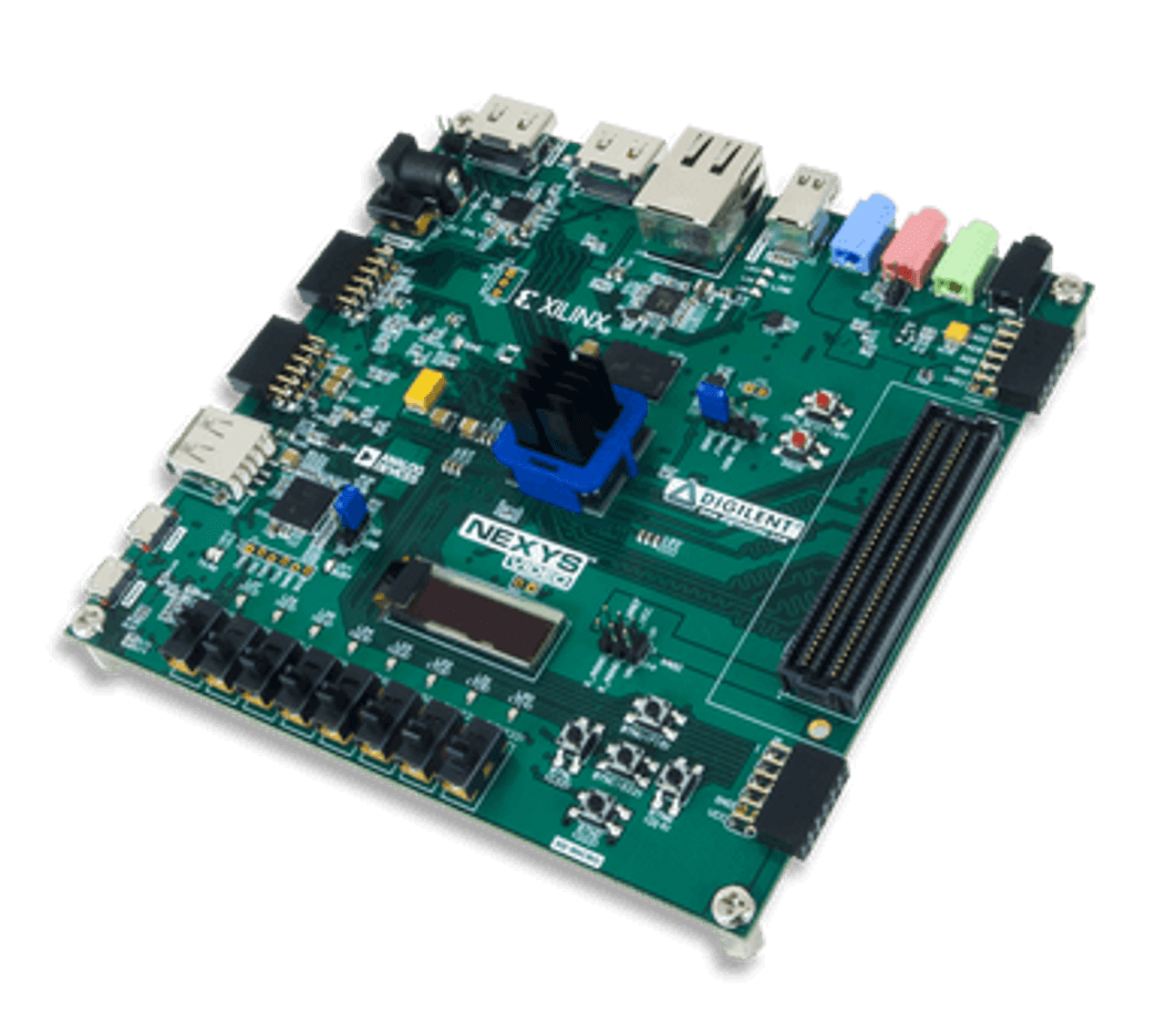
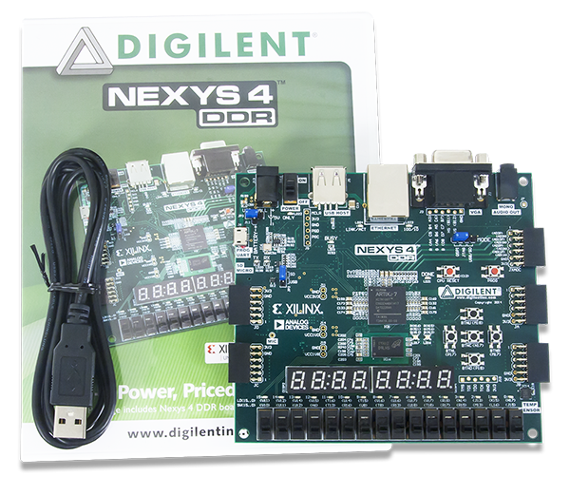
Outline
Project implements Autonoma Processor logic on FPGA
Skills used:
Python scripts
Verilog Coding
Using Vivado Toolset
Nexys 4 DDR Nexys Video

Slide 3
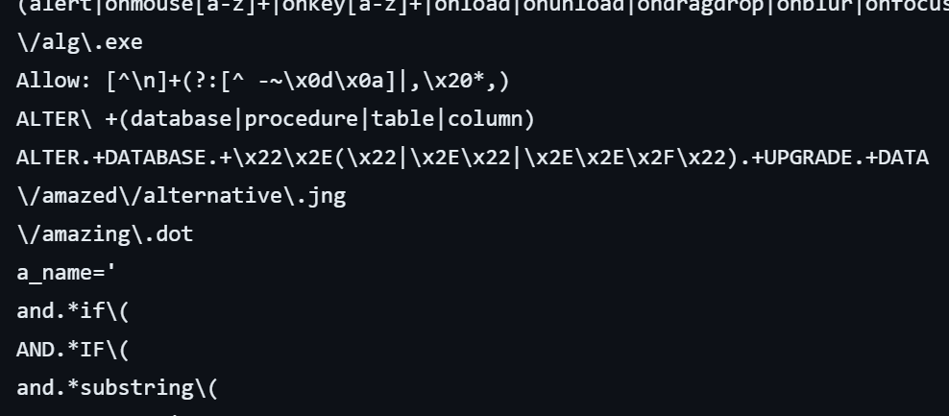
Autonoma Processing
Looking for Patterns in Data is common in many algorithms
Log Parsing
Natural Language processing
XML processing
Data processing for ML
Using Autonoma Processing one could create accelerator for these workloads
Searching Patterns in String data using main processors
Inefficient use of hardware resources
Slow for big data
Example patterns →

Slide 4
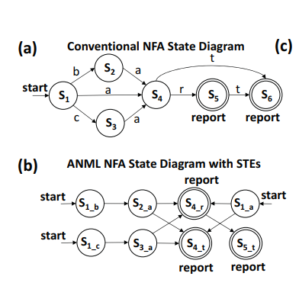
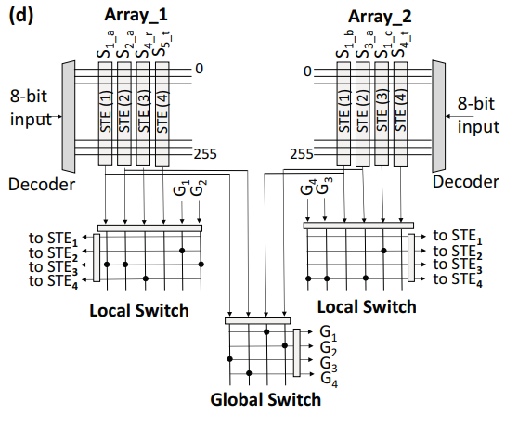
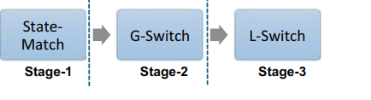
Cache Autonoma Paper
Turn Pattern searching for into a graph to process → utilized Cache
Ex Pattern: {bat, bar, bart, ar, at, art, car, cat, cart}

Slide 5
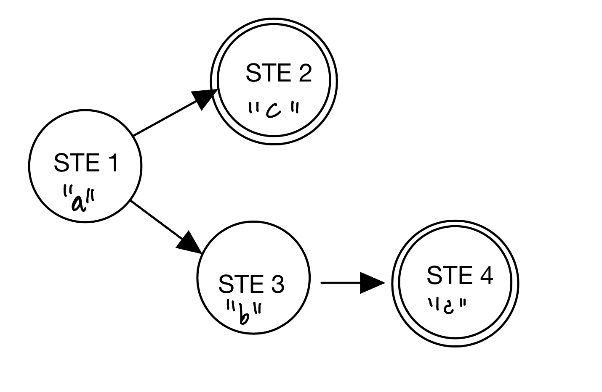
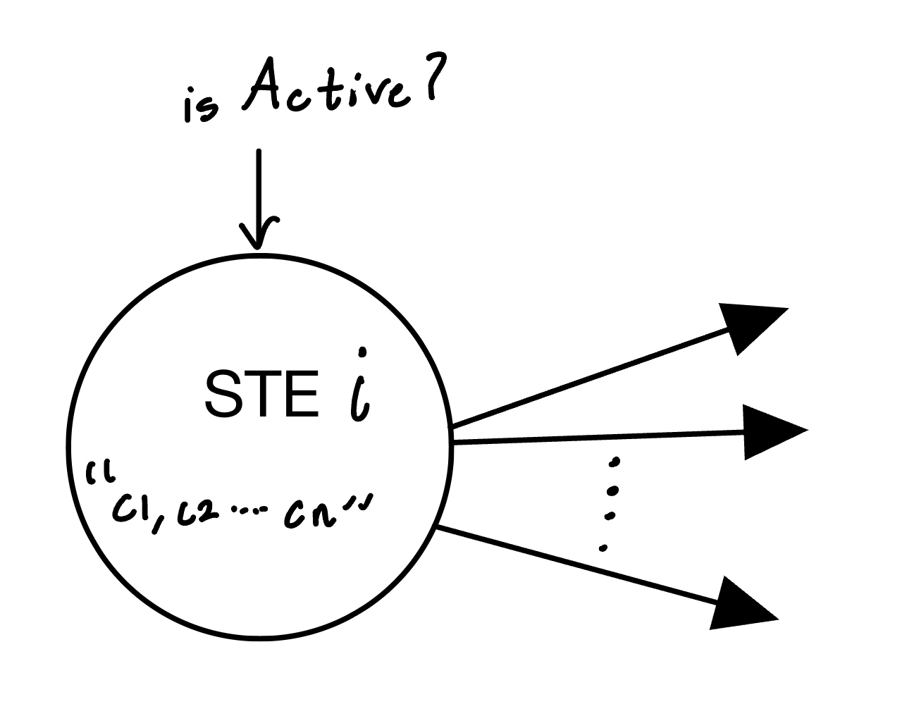
Background: State Transition Elements (STEs)
Regex that accepts: has “abd” or “ac” → abd|ac

Slide 6
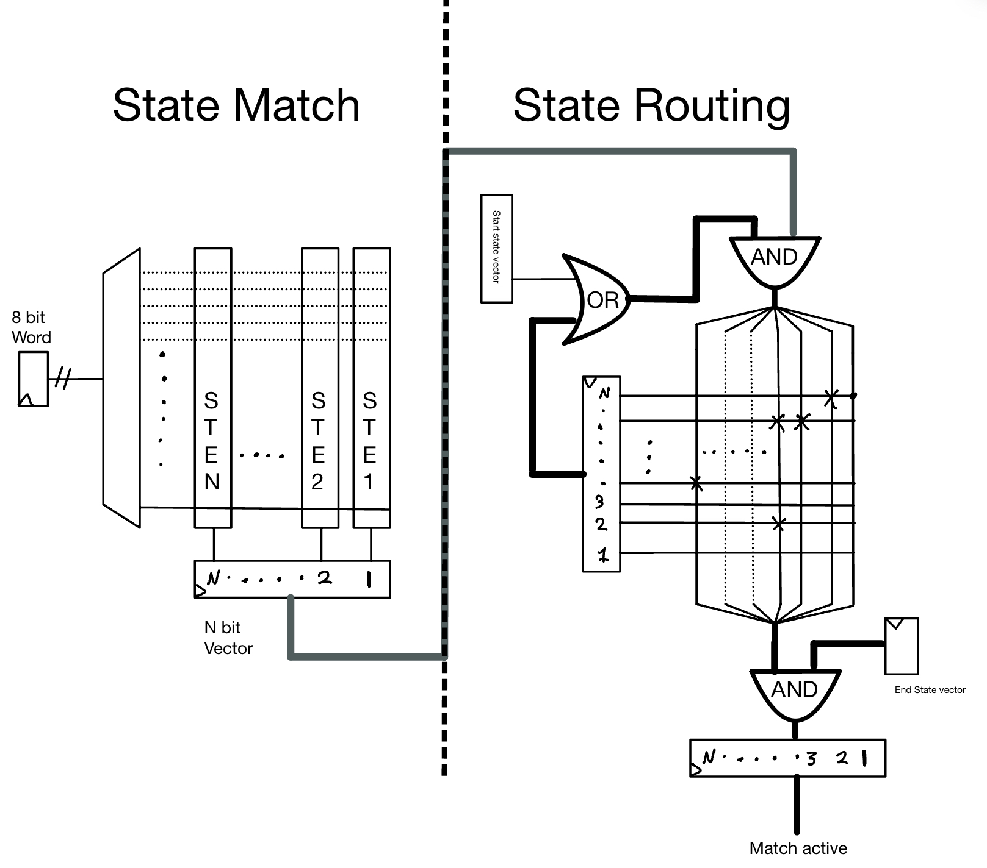
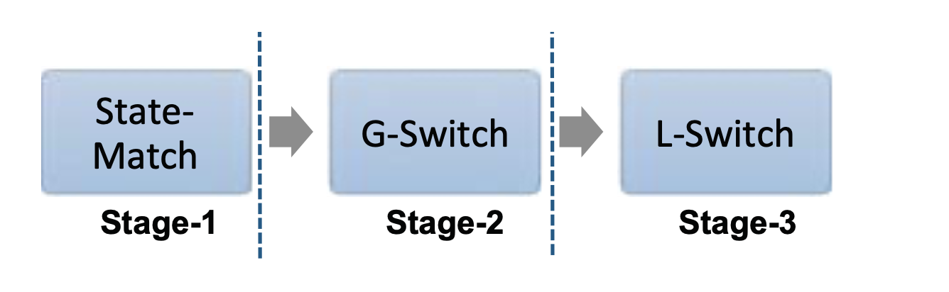
My Current Design and Architecture
Bypassed
Python Script which makes a N STE CA processor with parameters based on input graph
Three main inputs:
Word 8 bit
Clk
RST
First Active activate
2 Cycles per word pipelinned

Slide 7
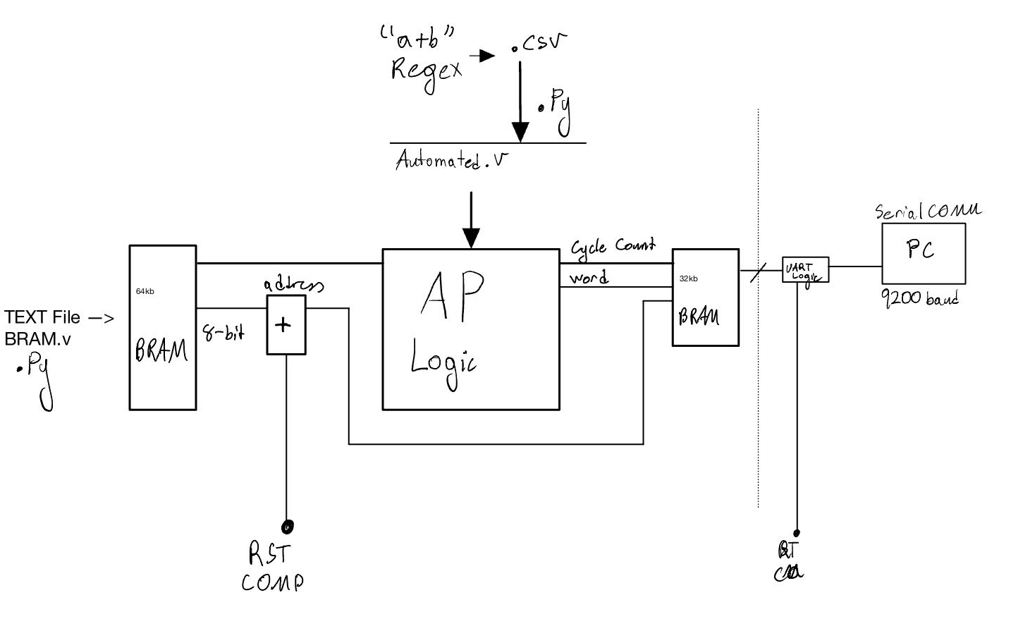
Overall Scheme
Scripts used:
Generate IP (AP Logic)
Generate BRAM logic
COM UART
Two Inputs:
Regular Expressions
String Data

Slide 8
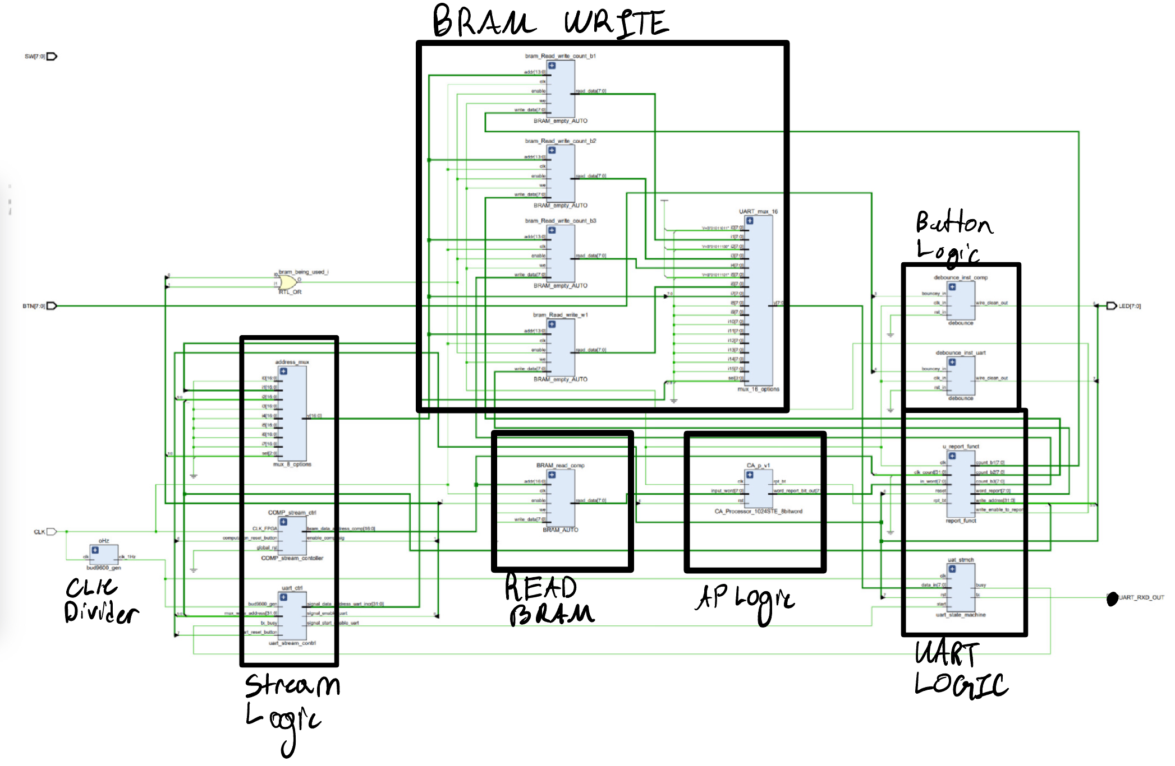
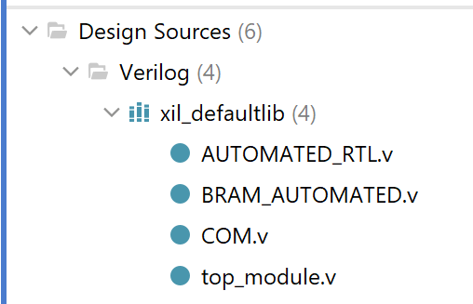
Overall Scheme in RTL

Slide 9
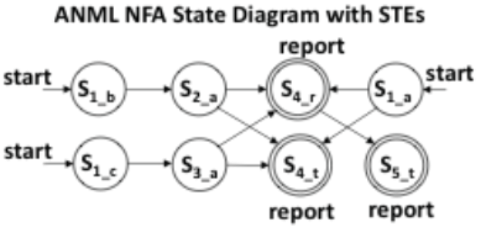
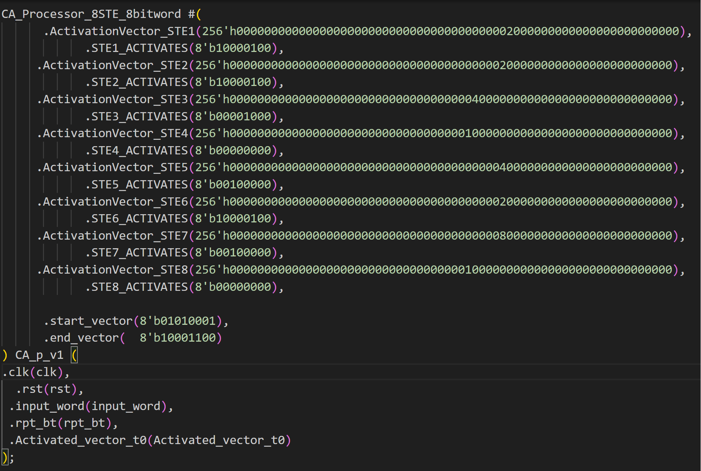
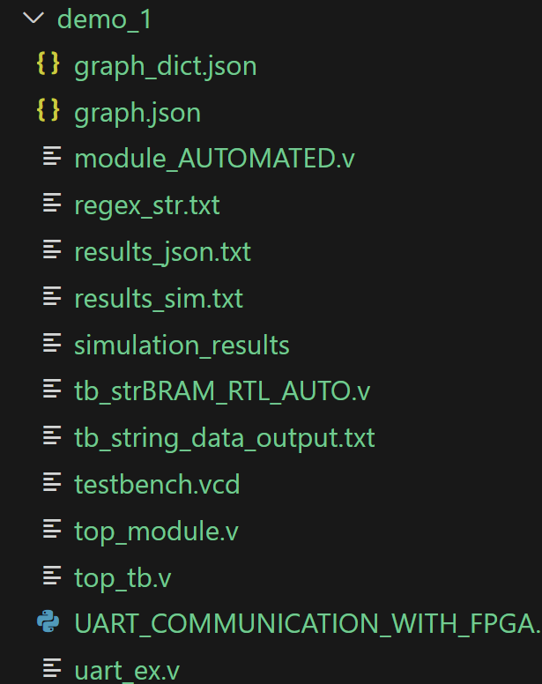
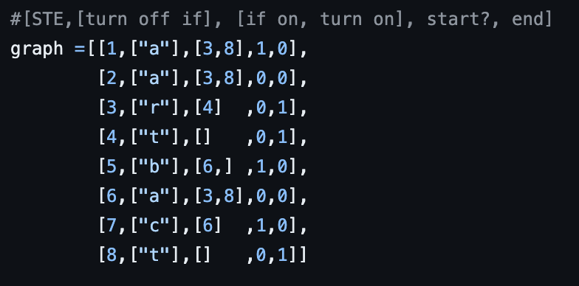
AP Logic Script Flow
Regex:{bat, bar, bart, ar, at, art, car, cat, cart}

Slide 10
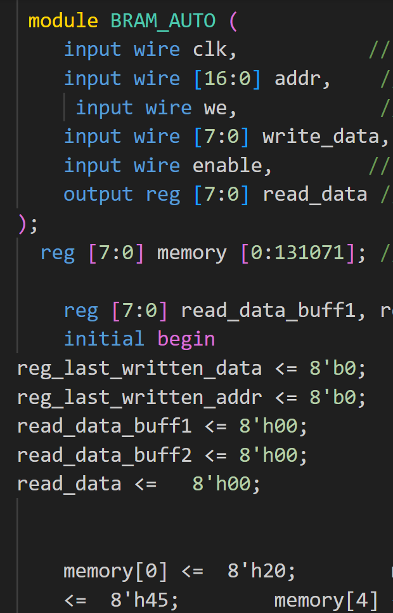
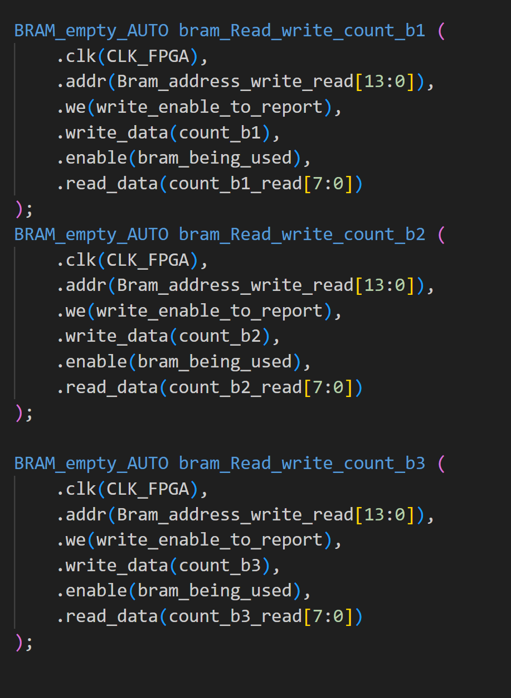
Data Stream Script Flow
Enter Text data: “abc”
{0x61,0x62,0x63}
ASCII Values

Slide 11
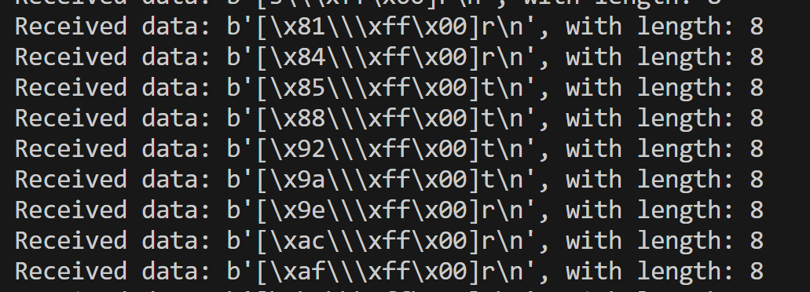
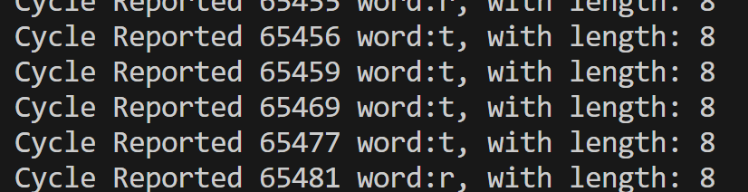
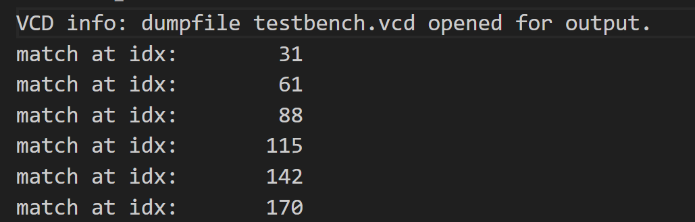
COMM Script
Reads outs Memory processed on BRAM
[clk_byte1,clk_byte2,clk_byte3] word sensed
Works for 32-64-128-630 STE → Simulation reports match Hardware reports
Raw serial Input Post-UART Script
Simulation Results

Slide 12
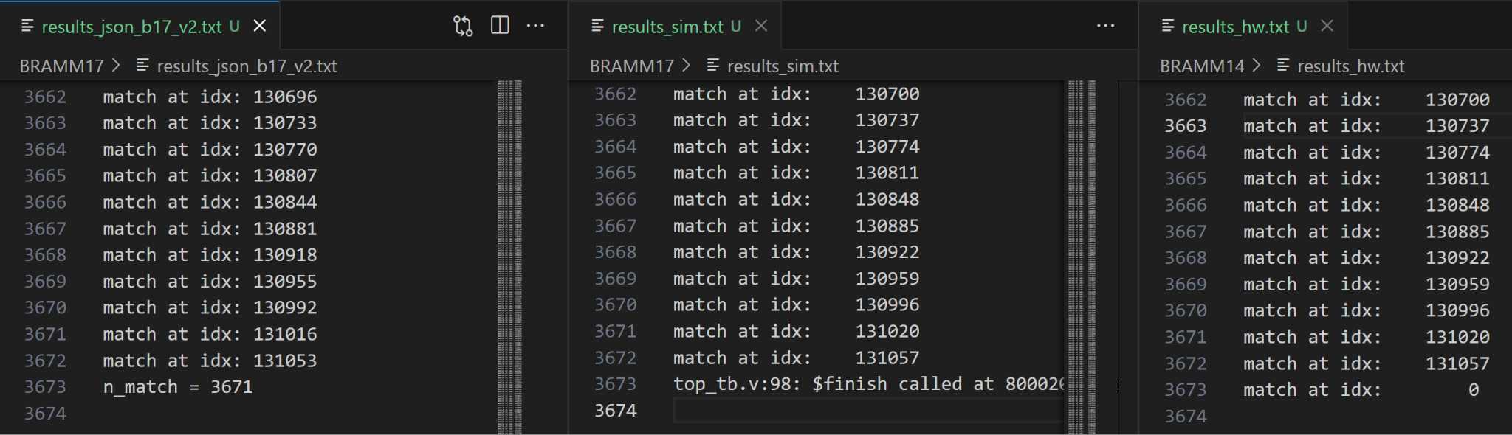
Validating Scripts
Expected Simulated Hardware FPGA
Pulled example Regex from regex-codesign

Slide 13
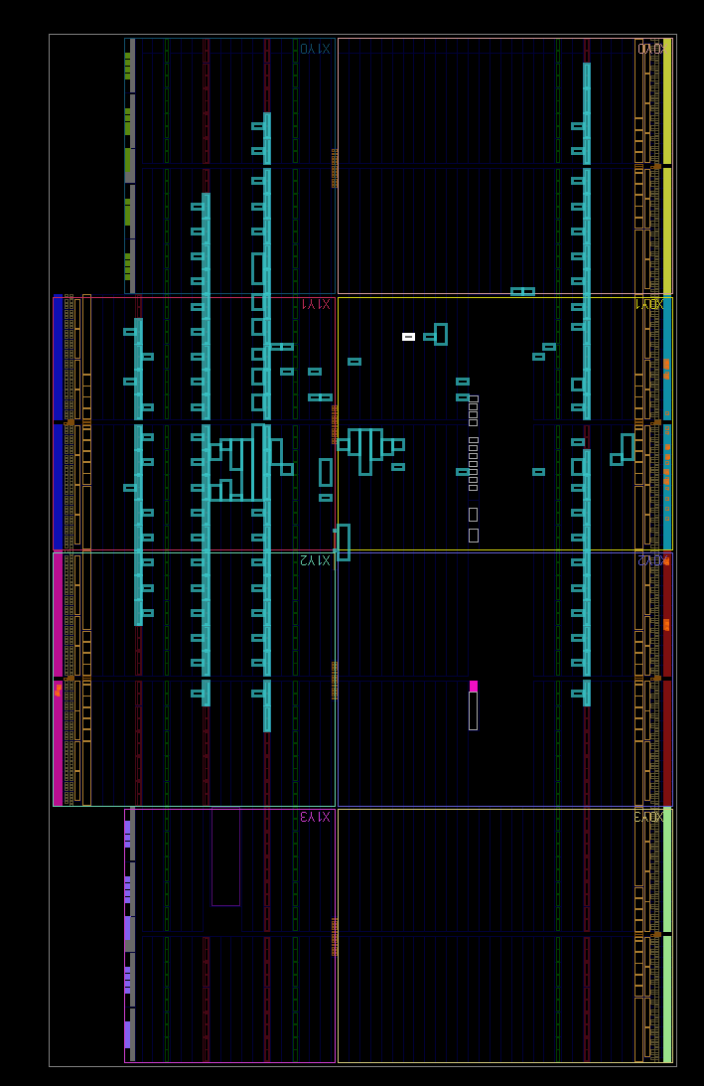
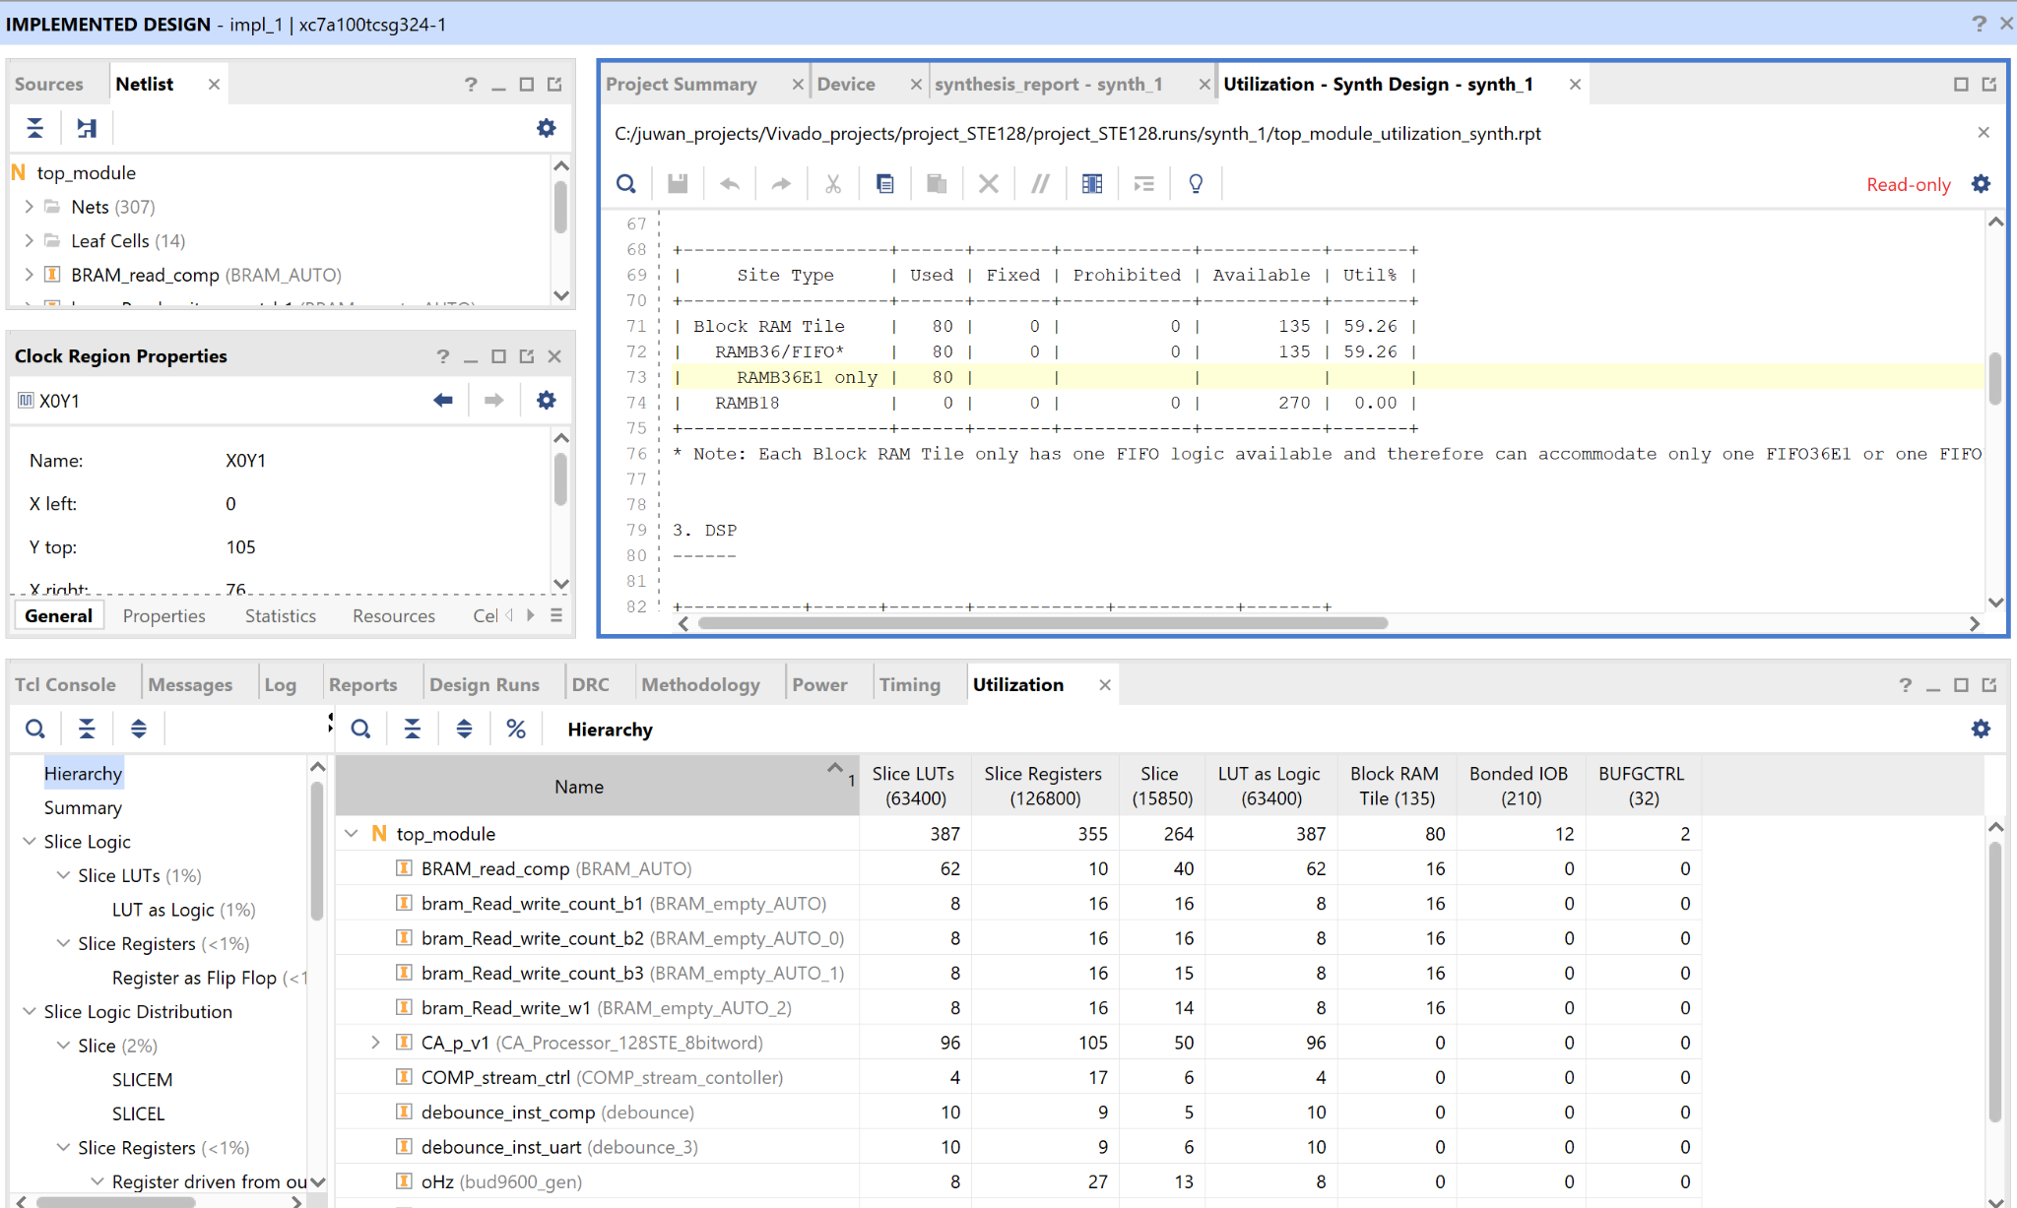
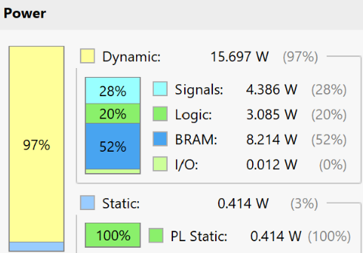
Vivado Tool Side
128 STE, 65kb Example below
reg_exp = "mi.....ft|b[aeiou]bble|[Bb]rainf\*\*k|g(oog)+le|^[a-zA-Z0-9+_.-]+@[a-zA-Z0-9.-]|(0[1-9]|[12][0-9]|3[01])\/(0[1-9]|1[1,2])\/(19|20)\d{2}|bat|bar|bart|ar|at|art|car|cat|cart|word1|word4|qtpie|qtwor|word|9|a*b"

Slide 14
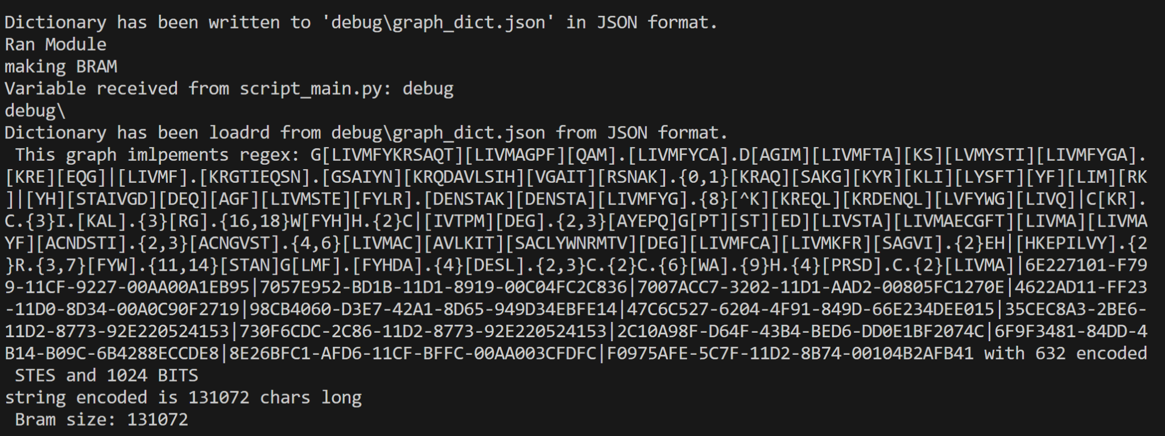
Performance
Whats Next
Fastest Validated Design: 100Mhz
Largest Validated STEs: 632 STEs
Largest Fully Validated BRAM: ~130k
Time to complete ~BRAM_size_n*10^-8 sec
Runs regex from Datasets
Testing Bigger Designs
Changing Architecture
More programmable functions

Slide 15
END

Slide 16
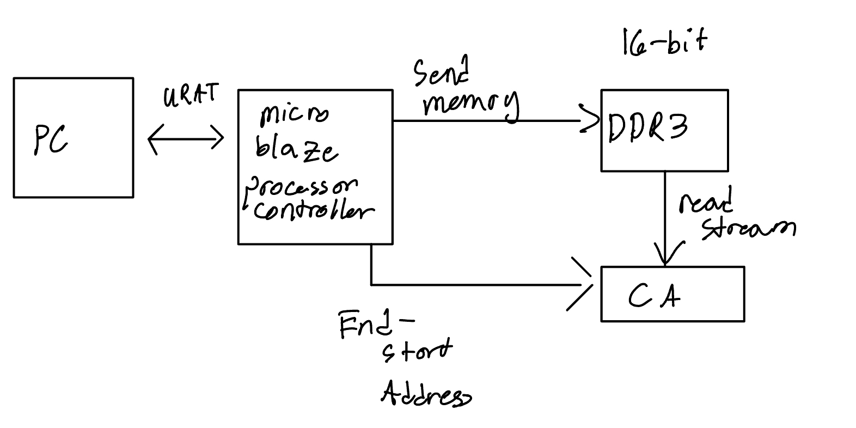
PAST SCHEME
FPGA has option for controller which streams data into DRAM and also DMA
200 Mhz Controller MAX
100 Mhz recommended

